Slide 1
PERFORMANCE ANALYSIS OF FULL ADDER CIRCUITS USING THRESHOLD LOGIC
PROJECT MEMBERS:
V.P.Veena Lakshmi- 18091A04N6
N.Narendra - 18091A04C1
P.Siri Chandana- 18091A04J7
P.Mohammad Rafi- 17091A0496
HEAD OF THE DEPARTMENT:
Dr. K.Mallikarjuna.
Professor & HOD
M.Tech,Ph.D,MISTE,FIETE,MIE.
PROJECT GUIDE:
Dr. N.Ramanjaneyulu.
Associate Professor
M.Tech,Ph.D,MIETE.

Slide 2
CONTENTS
Abstract
Introduction
Literature Survey
Problem Statement
Methodology
Results

Slide 3
ABSTRACT
Physical size, Power consumption and time delay become a considerable challenge and serious obstacle when increasing computing performance in artificial neural network. Full Adder circuits have been designed and simulated using Ganged CMOS, Beta driven threshold logic and Capacitive Output wired logic respectively. The simulation studies of the circuits have been carried out in different technology nodes. The minimization of time delay, consumed power and physical size of such circuits are the most essential requirements for the use in artificial neural network.
This project mainly focused on finding out the suitable CMOS static circuit-based threshold logic for Full Adder, the essential parameters of the three circuits are compared and Capacitive Output wired logic-based design reveals the best result for all the parameters.

Slide 4
INTRODUCTION
Synapse is a structure in the nervous system that allows a signal to pass from one neuron to the next neuron or to a target effecter cell.
An artificial neuron is a mathematical function conceived as a model of biological neurons.
Threshold Logic Unit(TLU) or Linear Threshold Unit was the first artificial neuron proposed by Warren McCulloch and Walter Pitts in 1943.
The CMOS are considered as the most versatile component for designing threshold logic gates.
A TLG is having more than one binary inputs and a single binary output.

Slide 5
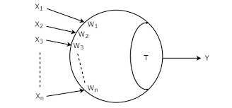
Threshold Logic-based design can operate at high speed in the
Input
Output
Fig.1. Threshold Logic Gate
T>=∑ XiWi ; Y=1 for i=1,2,…N
T<∑ XiWi ; Y=0 for i=1,2,3…N

Slide 6
LITERATURE SURVEY
S.No | Title of the paper | Authors | Publication details | Research Findings
1. | Weighted sum threshold logic operation of MOBILE (monostable-bistable transition logic element) using resonant tunneling transistors. | Akeyoshi.T MaezawaK. | IEEE Electron Device Letters | The functional operation of MOBILE (Monostable- Bistable Transition Logic Element) has been studied using multiple-input logic gate. The results signify the realization of the weighted sum threshold logic operation of the input signals.
2. | Ganged CMOS: Trading standby power for speed | Schultz K.J., Francis R.J., Smith K.C. | IEEE Journal of solid state | Fully complementary CMOS static circuits dissipate negligible dc power, can operate asynchronously and do not require the routing of clock signals.

Slide 7
PROBLEM STATEMENT
To minimize the power consumption, time delay and physical size of the circuits which are most essential requirements for the use in artificial neural networks.

Slide 8
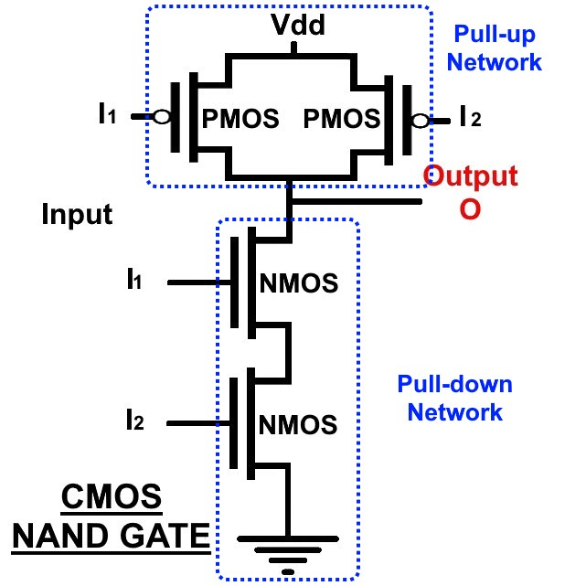
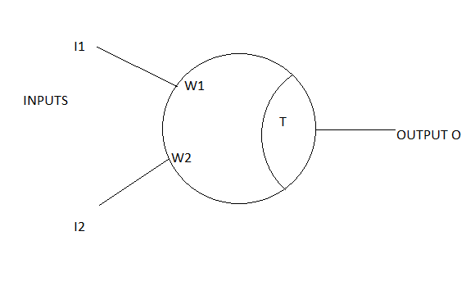
Realization of CMOS NAND gate

Slide 9
Table.1. Truth table for NAND Gate Using Threshold Logic
I1 | I2 | W1 | W2 | W1I1+W2I2 | Threshold Value(T) | Condition | Output
0 | 0 | 1 | 1 | 0 | -1 | 0>T | 1
0 | 1 | 1 | 1 | W2 | -1 | W2>T | 1
1 | 0 | 1 | 1 | W1 | -1 | W1>T | 1
1 | 1 | 1 | 1 | W1+W2 | -1 | T<W1+W2 | 0

Slide 10
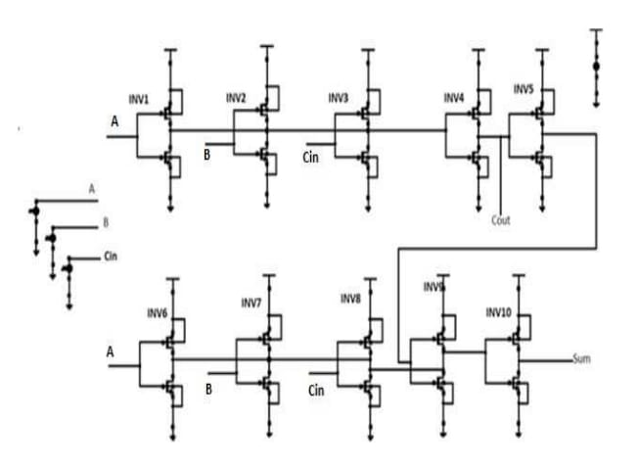
DIFFERENT REALIZATIONS OF FULL ADDER CIRCUITS
Fig.2(a): Full adder circuit using Ganged CMOS

Slide 11
Table.2. Truth Table of Full Adder Circuit
A | B | Cin | Sum | Carry
0 | 0 | 0 | 0 | 0
0 | 0 | 1 | 1 | 0
0 | 1 | 0 | 1 | 0
0 | 1 | 1 | 0 | 1
1 | 0 | 0 | 1 | 0
1 | 0 | 1 | 0 | 1
1 | 1 | 0 | 0 | 1
1 | 1 | 1 | 1 | 1

Slide 12
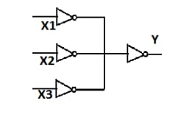
3.
Input’s
Output
Fig.2(b) Ganged CMOS Circuit

Slide 13
Truth Table for Ganged CMOS
X1 | X2 | X3 | W1 | W2 | W3 | W1X1+W2+X2+W3X3 | T | Condition | Output
0 | 0 | 0 | 1 | 1 | 1 | 0 | 1.5 | T<0 | 0
0 | 0 | 1 | 1 | 1 | 1 | W3 | 1.5 | W3<T | 0
0 | 1 | 0 | 1 | 1 | 1 | W2 | 1.5 | W2<T | 0
0 | 1 | 1 | 1 | 1 | 1 | W2+W3 | 1.5 | W2+W3>T | 1
1 | 0 | 0 | 1 | 1 | 1 | W1 | 1.5 | W1<T | 0
1 | 0 | 1 | 1 | 1 | 1 | W1+W3 | 1.5 | W1+W3>T | 1
1 | 1 | 0 | 1 | 1 | 1 | W1+W2 | 1.5 | W1+W2>T | 1
1 | 1 | 1 | 1 | 1 | 1 | W1+W2+W3 | 1.5 | W1+W2+W3>T | 1

Slide 14
The fig 2(a) shows that the full adder circuit using Ganged CMOS . This circuit contains 10 inverter circuits. Then the average power, Delay(ps) can be calculated.
The fig 2(a) weights of the inputs of inverter 1,2,3 are equal and the ganged output is fed to the input of inverter 4 to finally produce Cout.
The sum output is taken from inverter 10 where the outputs of inverter 6,7,8,9 are tied together to form the another node which is basically at the input of inverter 10.
The fig 2(b) shows the ganged CMOS circuit. In this circuit the binary inputs are fed into the input inverter array and outputs of all these inverters are shorter together which is ganged node.

Slide 15
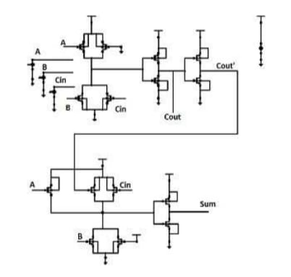
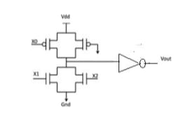
Fig 3(a) Full adder using Beta-Driven Threshold Logic
Fig 3(b) Beta-Driven Threshold Logic

Slide 16
METHODOLOGY
The Full adder circuits are designed in different technology using different threshold logic approaches and their power consumption and time delay is analyzed and compared in terms of delay.

Slide 17
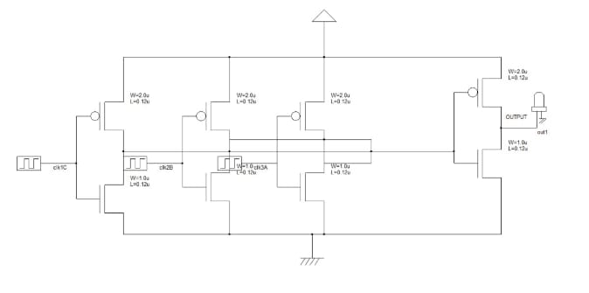
RESULTS
Vdd
Cout
A
B
C
Gnd
Fig.4(a) . Ganged CMOS circuit in DSCH2

Slide 18
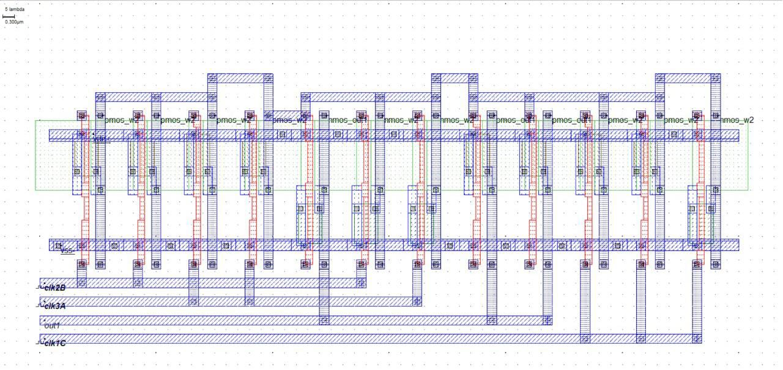
Fig.3(b). Layout of Ganged CMOS Circuit

Slide 19
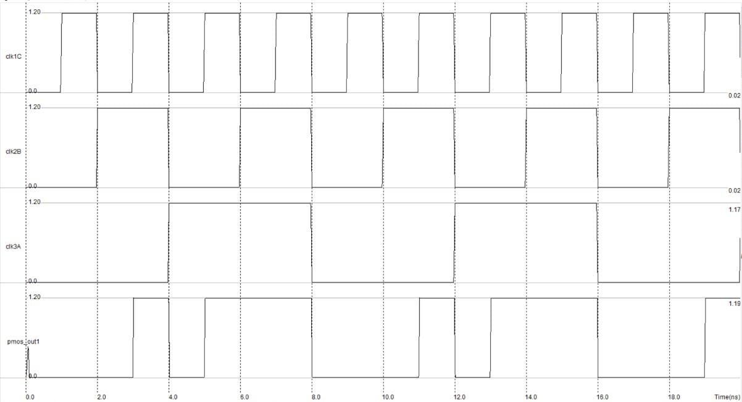
A
B
C
Cout
0 1 0 1 0 1 0 1 0 1 0 1 0 1 0 1 0 1 0 1
0 0 1 1 0 0 1 1 0 0 1 1 0 0 1 1 0 0 1 1
0 0 0 0 1 1 1 1 0 0 0 0 1 1 1 1 0 0 0 0
0 0 0 1 0 1 1 1 0 0 0 1 0 1 1 1 0 0 0 1
Fig.3(c).Voltage versus time waveforms

Slide 20
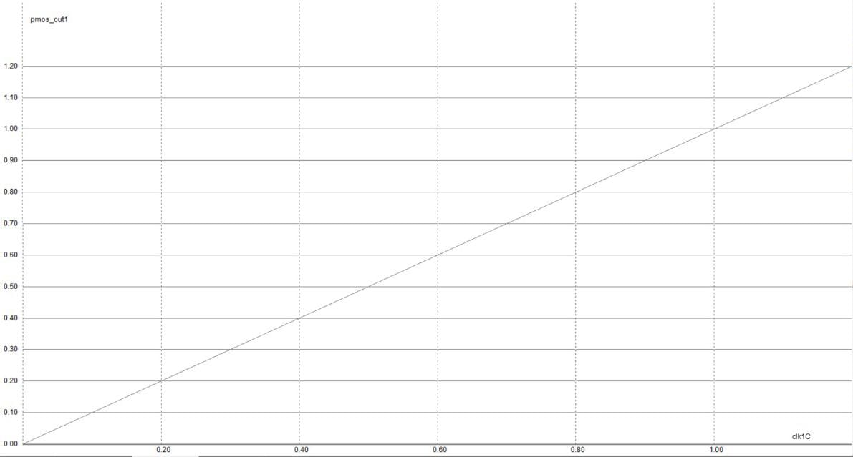
Fig.3(d).Voltage versus Voltage waveform of Ganged CMOS

Slide 21
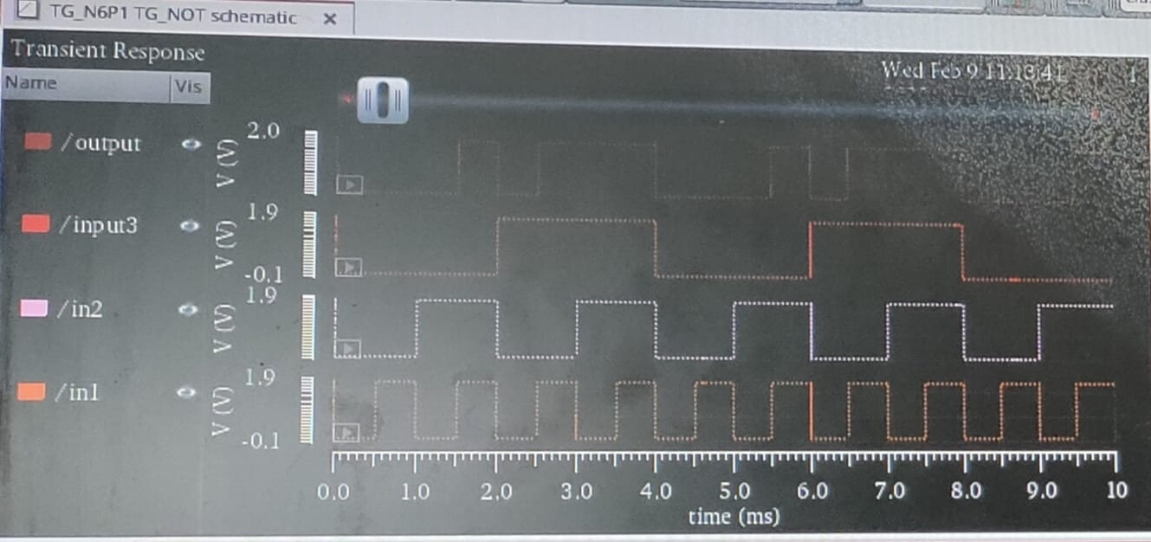
Ganged CMOS Waveforms

Slide 22
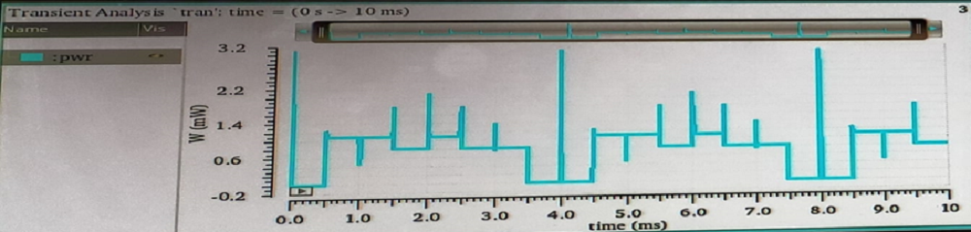
Ganged CMOS Power

Slide 23
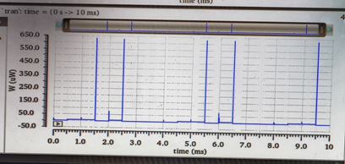
Ganged CMOS (PMOS)

Slide 24
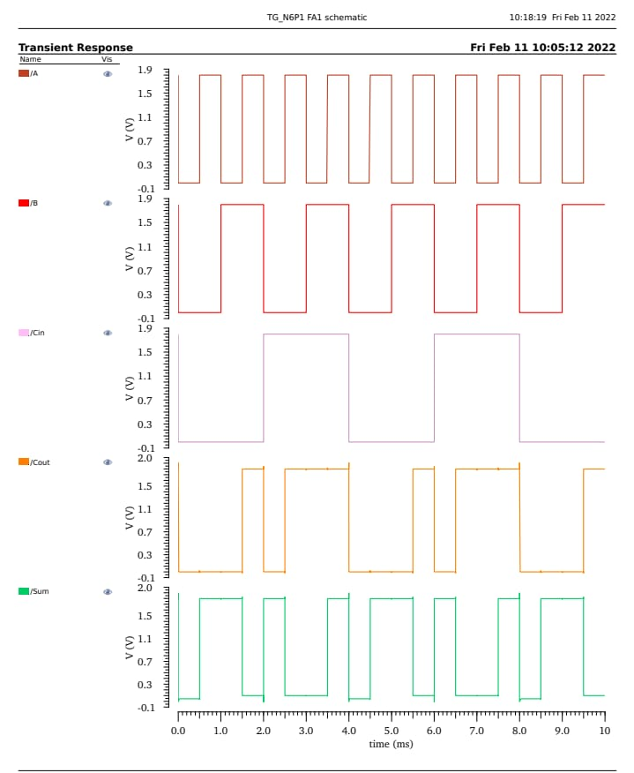
Full Adder Ganged CMOS Waveforms
A
B
Cin
Cout
Sum
0 1 0 1 0 1 0 1 0 1 0 1 0 1 0 1 0 1 0 1
0 0 1 1 0 0 1 1 0 0 1 1 0 0 1 1 0 0 1 1
0 0 0 0 1 1 1 1 0 0 0 0 1 1 1 1 0 0 0 0
0 0 0 1 0 1 1 1 0 0 0 1 0 1 1 1 0 0 0 1
0 1 1 0 1 0 0 1 0 1 1 0 1 0 0 1 0 1 1 0

Slide 25
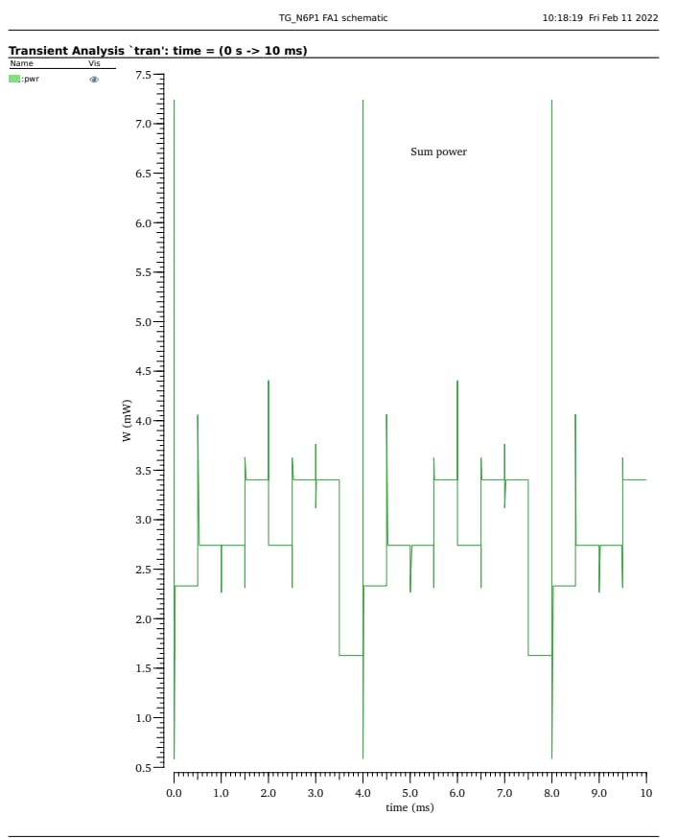
Sum Power
Pwr

Slide 26
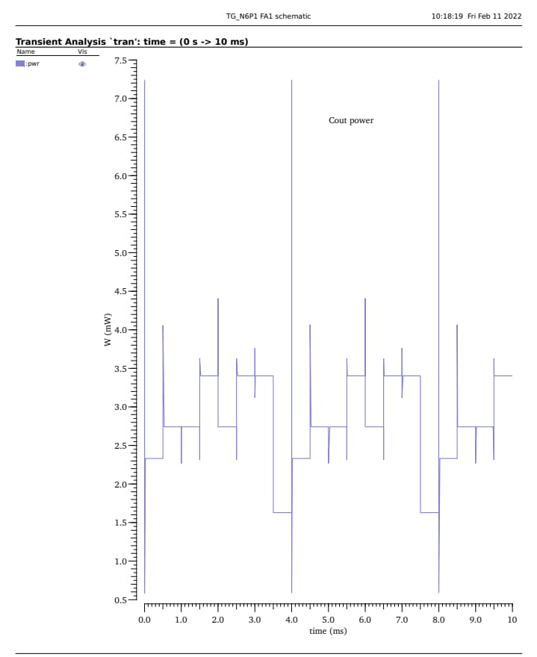
Carry Power
Pwr

Slide 27
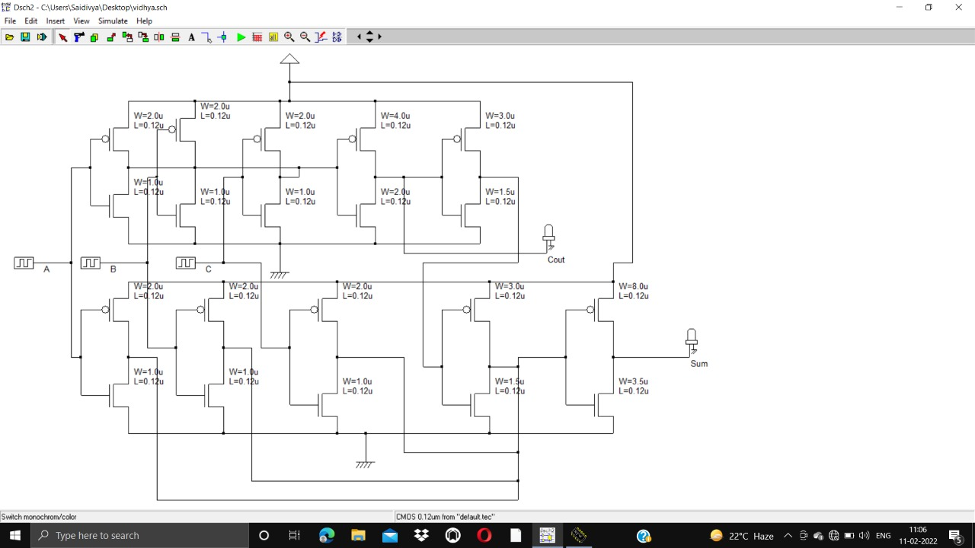
Using Micro-wind Full Adder GCMOS

Slide 28
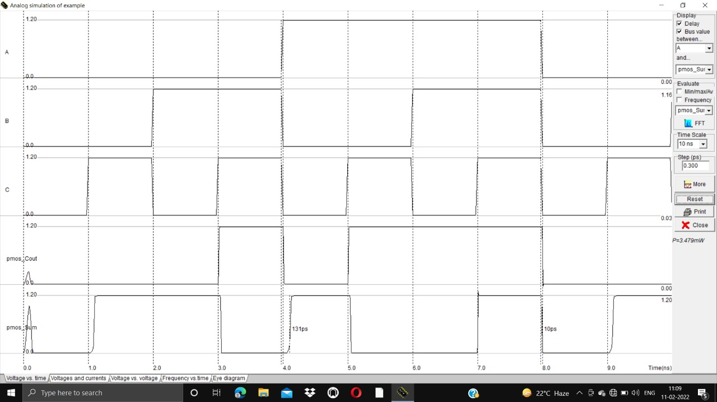
A
B
C
Cout
Sum
0 0 0 0 1 1 1 1 0 0
0 0 1 1 0 0 1 1 0 0
0 1 0 1 0 1 0 1 0 1
0 0 0 1 0 1 1 1 0 0
0 1 1 0 1 0 0 1 0 1

Slide 29
Table.4. Ganged CMOS circuit output in different technologies by using Microwind2
Technology | Average Power | Delay(ps) | PDP(fJ)
70nm | 0.317mW | 13ps | 4.1
180nm | 1.919mW | 21ps | 40.3
90nm | 0.646mW | 17ps | 10.98

Slide 30
Table.5. Ganged CMOS output wired TL based Full Adder in different technologies by using Microwind2
Technology | Average Power | Delay | PDP(fJ)
70nm | 1.113mW | 48ps[4.8E-8] | 53.4
90nm | 2.282mW | 1000ps[1E-6] | 2285
Table.6. Ganged CMOS output wired TL based Full Adder in different technologies by using Cadence
Technology | Average Power | Delay | PDP
180nm | 2.801E-3 | 1.500E-3 | 4.2015uJ

Slide 31
THANK YOU

